Slide 1
Chapter 8 Multidimensional Arrays

Slide 2
Motivations
Thus far, you have used one-dimensional arrays to model linear collections of elements. You can use a two-dimensional array to represent a matrix or a table. For example, the following table that describes the distances between the cities can be represented using a two-dimensional array.

Slide 3
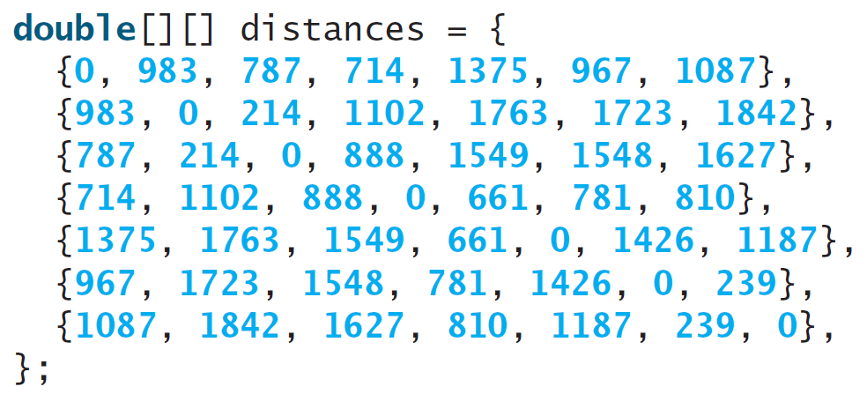
Motivations

Slide 4
Objectives
To give examples of representing data using two-dimensional arrays (§8.1).
To declare variables for two-dimensional arrays, create arrays, and access array elements in a two-dimensional array using row and column indexes (§8.2).
To program common operations for two-dimensional arrays (displaying arrays, summing all elements, finding the minimum and maximum elements, and random shuffling) (§8.3).
To pass two-dimensional arrays to methods (§8.4).
To write a program for grading multiple-choice questions using two-dimensional arrays (§8.5).
To solve the closest-pair problem using two-dimensional arrays (§8.6).
To check a Sudoku solution using two-dimensional arrays (§8.7).
To use multidimensional arrays (§8.8).

Slide 5
Declare/Create Two-dimensional Arrays
// Declare array ref var
dataType[][] refVar;
// Create array and assign its reference to variable
refVar = new dataType[10][10];
// Combine declaration and creation in one statement
dataType[][] refVar = new dataType[10][10];
// Alternative syntax
dataType refVar[][] = new dataType[10][10];

Slide 6
Declaring Variables of Two-dimensional Arrays and Creating Two-dimensional Arrays
int[][] matrix = new int[10][10];
or
int matrix[][] = new int[10][10];
matrix[0][0] = 3;
for (int i = 0; i < matrix.length; i++)
for (int j = 0; j < matrix[i].length; j++)
matrix[i][j] = (int)(Math.random() * 1000);
double[][] x;

Slide 7
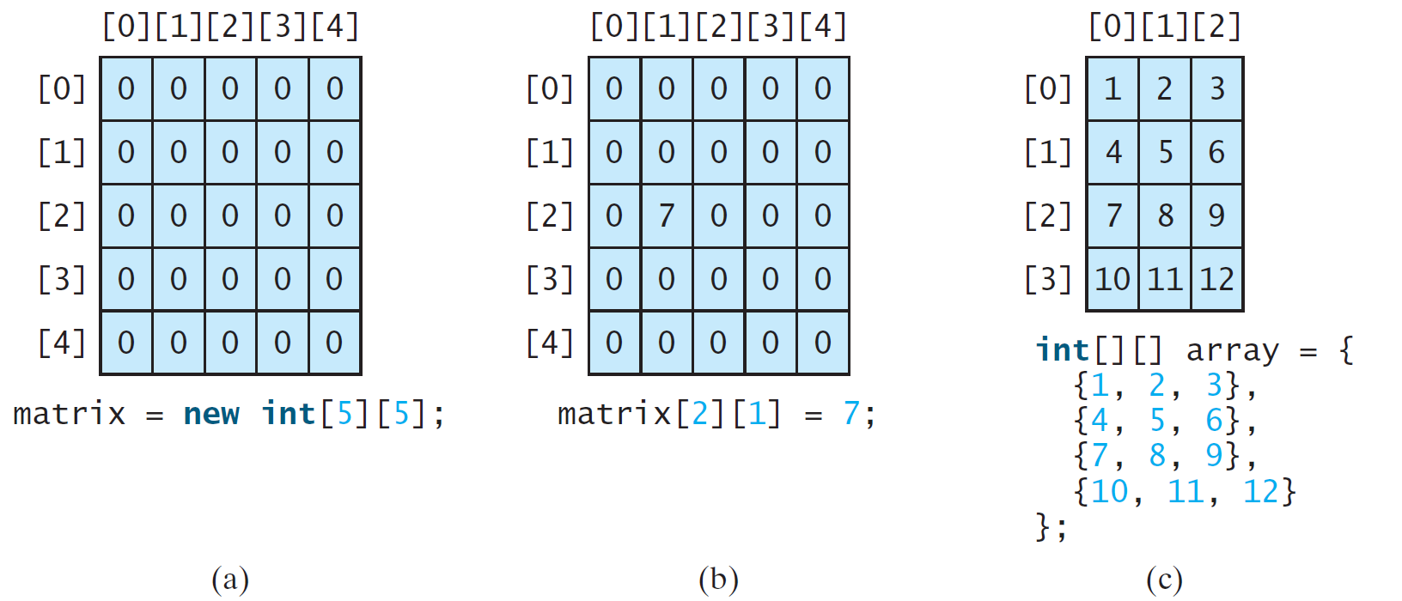
Two-dimensional Array Illustration
matrix.length? 5
matrix[0].length? 5
array.length? 4
array[0].length? 3

Slide 8
Declaring, Creating, and Initializing Using Shorthand Notations
You can also use an array initializer to declare, create and initialize a two-dimensional array. For example,
int[][] array = {
{1, 2, 3},
{4, 5, 6},
{7, 8, 9},
{10, 11, 12}
};
int[][] array = new int[4][3];
array[0][0] = 1; array[0][1] = 2; array[0][2] = 3;
array[1][0] = 4; array[1][1] = 5; array[1][2] = 6;
array[2][0] = 7; array[2][1] = 8; array[2][2] = 9;
array[3][0] = 10; array[3][1] = 11; array[3][2] = 12;
Same as

Slide 9
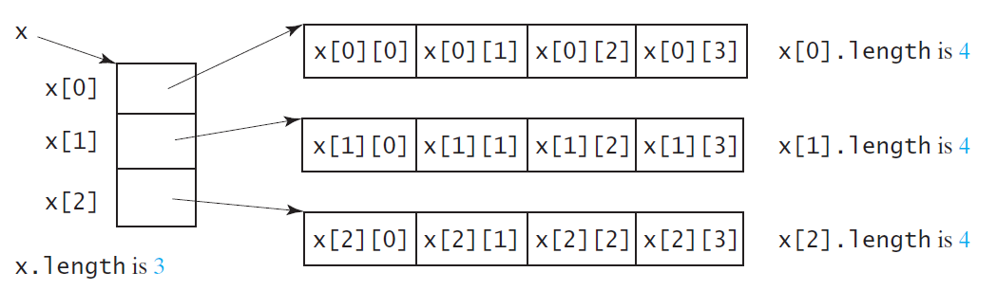
Lengths of Two-dimensional Arrays
int[][] x = new int[3][4];

Slide 10
Lengths of Two-dimensional Arrays, cont.
int[][] array = {
{1, 2, 3},
{4, 5, 6},
{7, 8, 9},
{10, 11, 12}
};
array.length
array[0].length
array[1].length
array[2].length
array[3].length
array[4].length ArrayIndexOutOfBoundsException

Slide 11
Ragged Arrays
Each row in a two-dimensional array is itself an array. So, the rows can have different lengths. Such an array is known as a ragged array. For example,
int[][] matrix = {
{1, 2, 3, 4, 5},
{2, 3, 4, 5},
{3, 4, 5},
{4, 5},
{5}
};
matrix.length is 5
matrix[0].length is 5
matrix[1].length is 4
matrix[2].length is 3
matrix[3].length is 2
matrix[4].length is 1

Slide 12
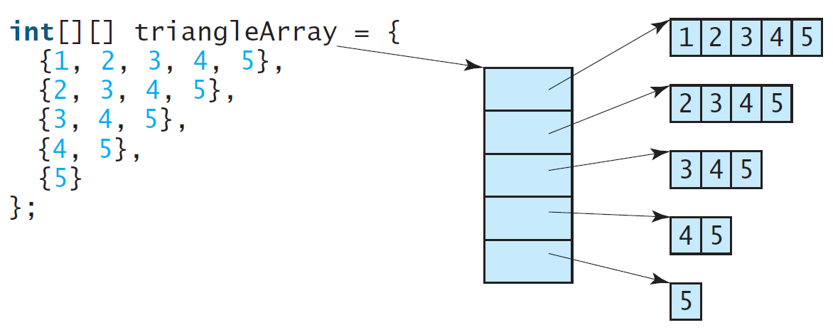
Ragged Arrays, cont.

Slide 13
Passing Tow-Dimensional Arrays to Methods
PassTwoDimensionalArray
Run

Slide 14
Multidimensional Arrays
Occasionally, you will need to represent n-dimensional data structures. In Java, you can create n-dimensional arrays for any integer n.
The way to declare two-dimensional array variables and create two-dimensional arrays can be generalized to declare n-dimensional array variables and create n-dimensional arrays for n >= 3.

Slide 15
Multidimensional Arrays
double[][][] scores = {
{{7.5, 20.5}, {9.0, 22.5}, {15, 33.5}, {13, 21.5}, {15, 2.5}},
{{4.5, 21.5}, {9.0, 22.5}, {15, 34.5}, {12, 20.5}, {14, 9.5}},
{{6.5, 30.5}, {9.4, 10.5}, {11, 33.5}, {11, 23.5}, {10, 2.5}},
{{6.5, 23.5}, {9.4, 32.5}, {13, 34.5}, {11, 20.5}, {16, 7.5}},
{{8.5, 26.5}, {9.4, 52.5}, {13, 36.5}, {13, 24.5}, {16, 2.5}},
{{9.5, 20.5}, {9.4, 42.5}, {13, 31.5}, {12, 20.5}, {16, 6.5}}};

